Slide 1
Case Study 01 July 29th 2019
Joe Chung and Jonathan Tan
Notes:
Greetings(Hello my name is), (thank you for the opportunity to present to you today) obeisances, ect (This is a presentation of finding on the beer and brewery data provided to us. Let’s jump right in)

Slide 2
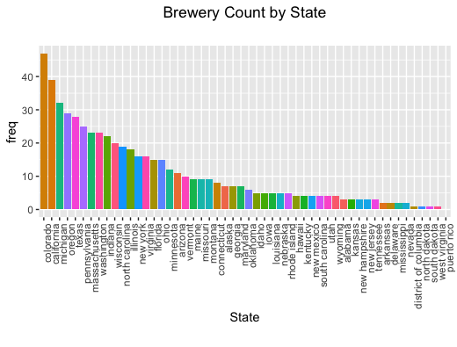
Brewery Distribution Per State
Most Breweries
Colorado
California
Michigan
Oregon
Texas
Notes:
Colorado has the highest number of breweries, followed by California, then Michigan

Slide 3
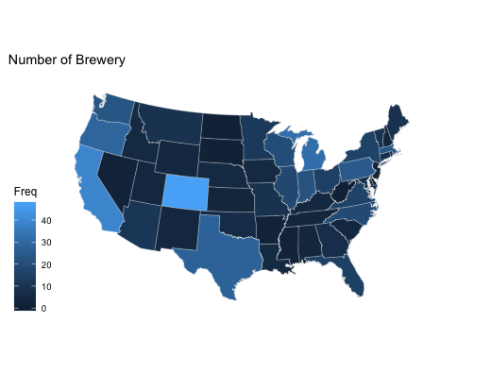
State Distribution of Breweries
More Breweries on the East Coast 15% (86/558) located in California and Colorado

Slide 4
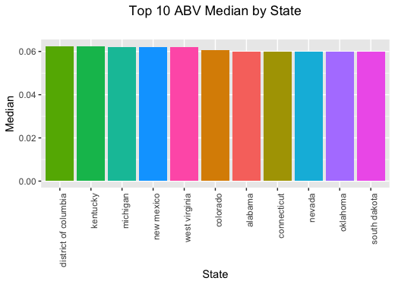
Median Alcohol Content By State
States that produce beer with the highest median ABV
District of Columbia
Kentucky
National ABV ranges from 1% to 12.8%
National median ABV is 5.6%
National Median ABV
Notes:
Mention State with Highest ABV Beers from the District of Columbia have the highest national median ABV

Slide 5
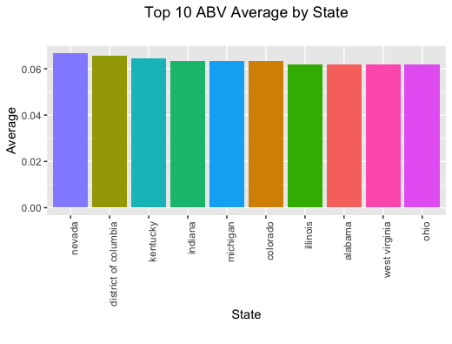
Average Alcohol Content By State
Highest ABV 12.5% Lowest ABV 2.7%
National Average alcohol content is 5.9%
National Average ABV
Notes:
Nevada’s positional shift from number 1 average abv to number 8 median abv indicates that at least some of its beers have unusually high alcohol content (outliers) compared to the rest of Nevada’s beers and the rest of the country

Slide 6
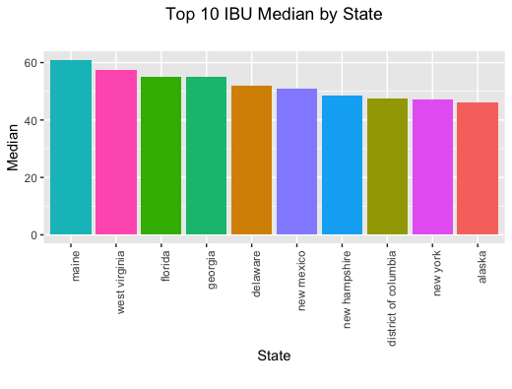
Median Bitterness by State
States that produce beer with the highest median IBU
Maine
West Virginia
National Median Bitterness is 35
National Median IBU
Notes:
Mention state with highest IBU Beers from Maine have the highest national IBU rating

Slide 7
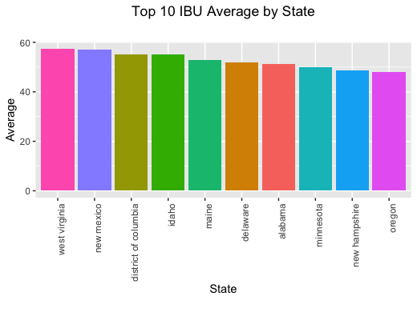
Average Bitterness By State
Highest IBU 138
Lowest IBU 4 Average National Bitterness is 42.7
National Average IBU
Notes:
West Virginia has a higher average IBU than median, indicating outliers with high IBU

Slide 8
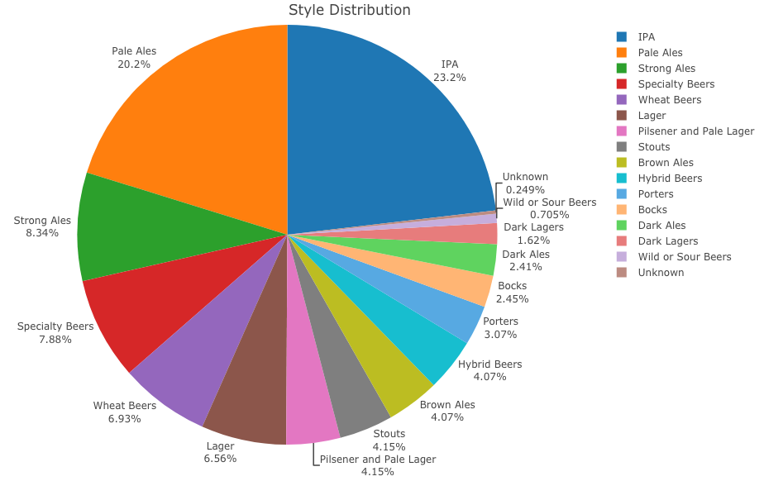

Slide 9
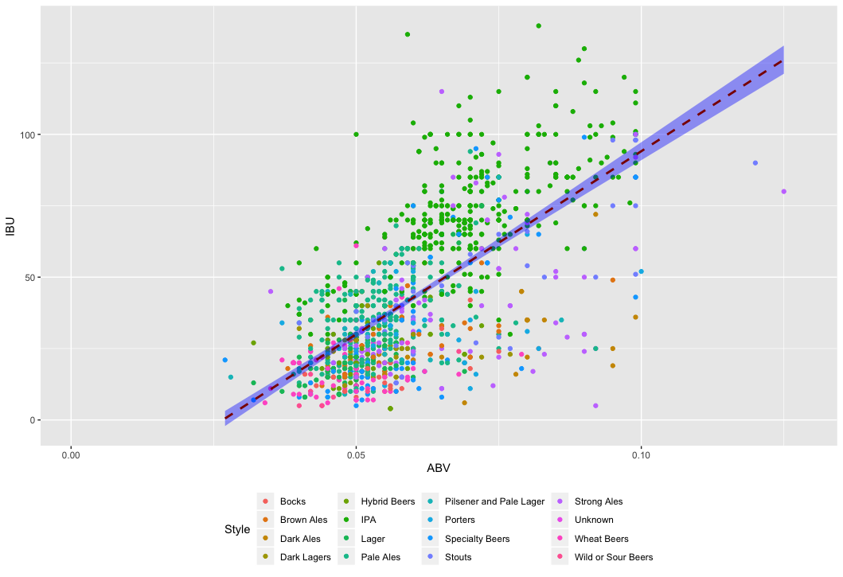
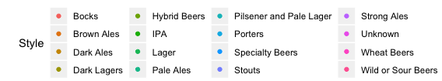
ABV vs IBU
Bitterness generally rises with alcohol content
96.2% of all reported beers have 100 IBU and 10% ABV or less
56.2% have 50 IBU or less, and 3-6% ABV
Notes:
Generally, the beers with higher alcoholic content have a higher bitterness rating 96.2% within 100 IBU 10% ABV (blue box) 56.2% within 50 IBU 3-6% ABV (red box)

Slide 10
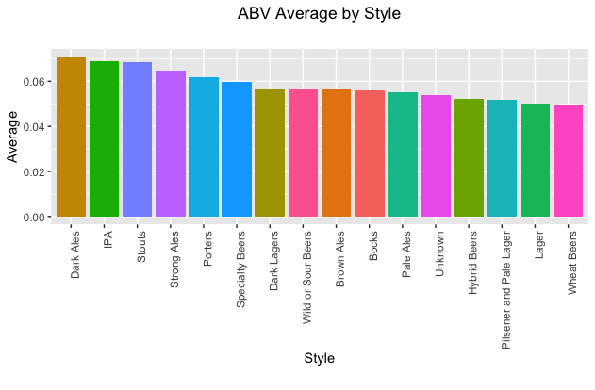
Average Alcohol Content by Style
Speciality Beers have unexpectedly high average ABV
Notes:
Speciality beers have an unexpectedly high ABV, National median ABV is 5.6% (grey line)

Slide 11
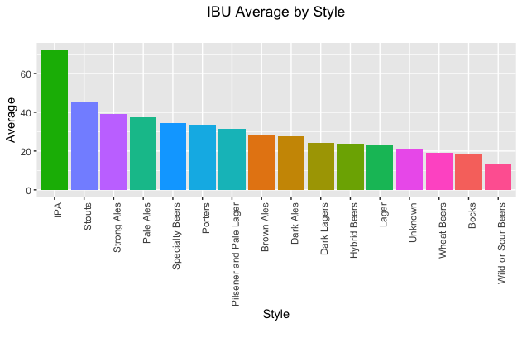
Average Bitterness by Style
IPA style beers have significantly above average bitterness ratings
National Average IBU
Notes:
IBU average is 35, Unknown category is made of 6 uncategorized styles

Slide 12
Analysis Factors
62 beers (2.5%) did not include data about alcohol content
1005 beers (41.7%) did not include data about bitterness rating
Notes:
Beers missing this data were not included the calculations for national averages and medians

Slide 13
Conclusions
Data suggests Colorado and California are the best states to open breweries
IPA style beers have production plurality
More than half of all reported beers (56.2%) are low IBU (<50) and 3-6% alcohol
Notes:
Thank you for the opportunity to present to you today. Additional questions about the material can be directed to myself or my partner at github.com/amigotomodachiami.

Slide 14
Documentation and Sources
Video Presentations
Chung
Youtube
Tan
Youtube
Project Repository
Github

